Slide 1
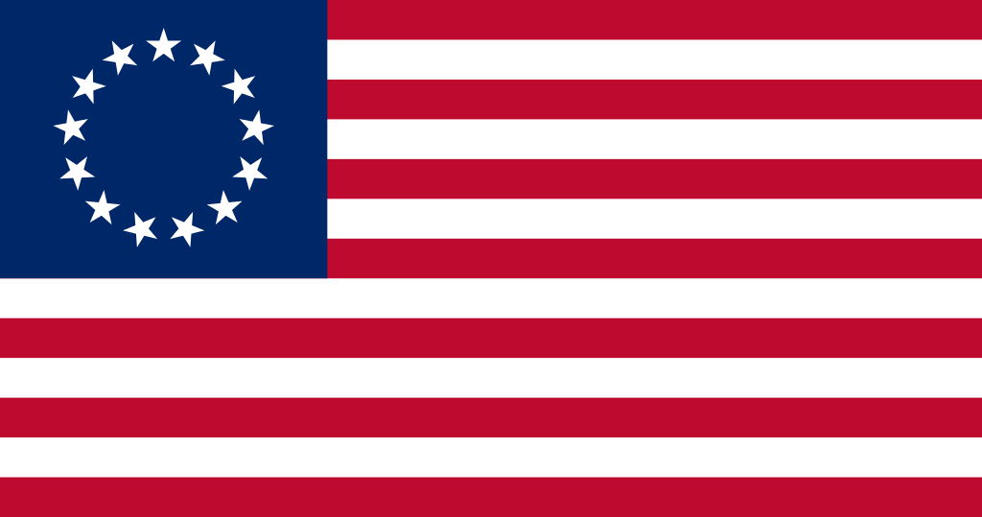
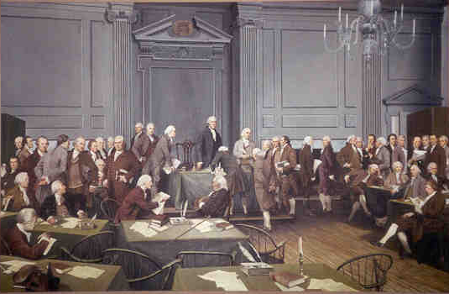
The Critical Period 1783-1789
What does this term mean?

Slide 2
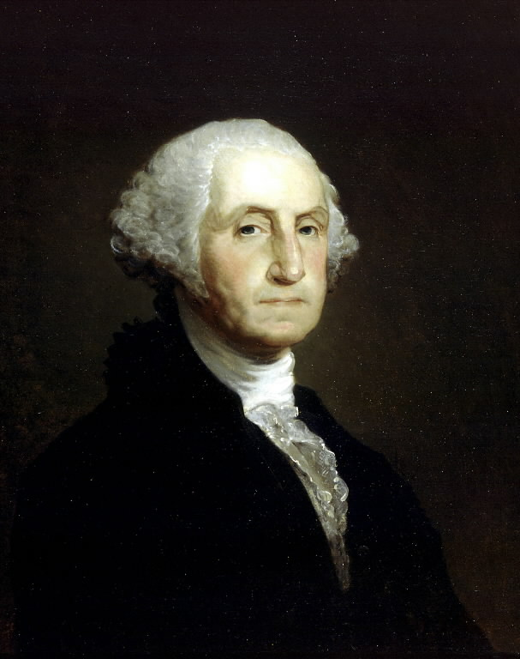
Articles of Confederation
I PREDICT THE WORST CONSEQUENCES FROM A HALF-STARVED, LIMPING GOVERNMENT, ALWAYS MOVING UPON THE CRUTCHES AND TOTERING AT EVERY STEP
1st government of the U.S. (written in 1777) until only 1787
Created “firm league of friendship” between the 13 states
Each state also had its own state constitution

Slide 3
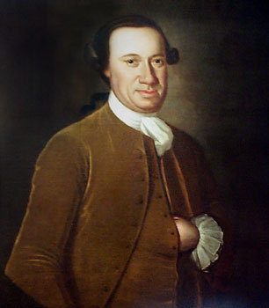
Organization of the A.O.C.
Made of one Congress in which each state got 1 vote
There was a president with very limited power- WHY?
Presidents of the Congress under the Articles of Confederation
President | Year
John Hanson | 1782
Elias Boudinot | 1783
Thomas Mifflin | 1784
Richard Henry Lee | 1785
John Hancock | 1786
Nathan Gorman | 1787
Arthur St. Clair | 1788
Cyrus Griffin | 1789

Slide 4
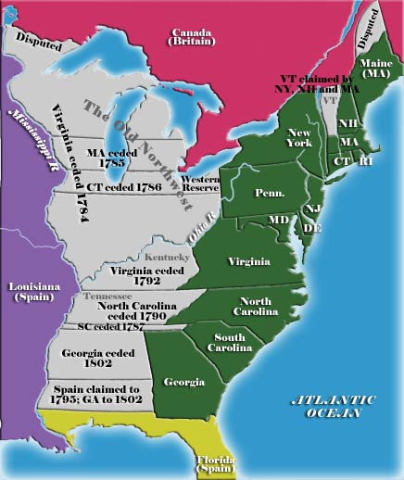
Powers of the Articles
The Federal government under the Articles could:
- Declare war and make peace
- Make treaties with foreign
countries
- Establish an army and navy
- Appoint high-ranking military
officials
- Print and borrow money
- Establish weights and measures
- Hear disputes among the states
related to trade or boundaries

Slide 5
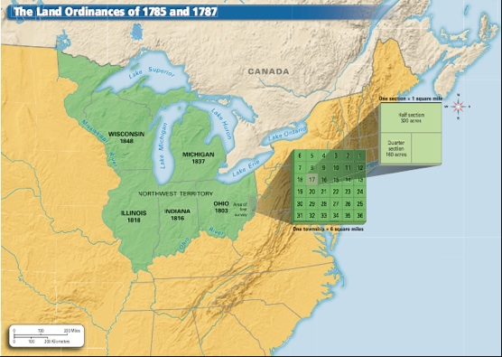
This Land is Whose Land?
One of the most important successes of the A.O.C. was the Land Ordinance of 1785- Set up townships in the West
The Northwest Ordinance of 1787
Allowed areas in west to become states with 60,000 free citizens
Banned slavery

Slide 6
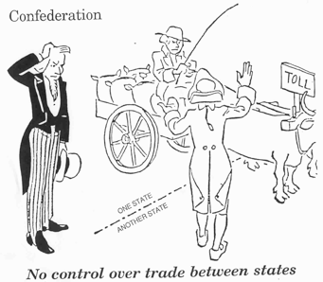
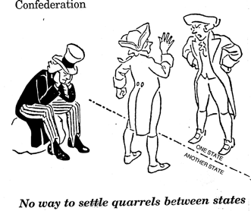
There’s a Reason Why it Didn’t Last Long
The Articles of Confederation was INEFFECTIVE:
No power to raise funds for an army or navy
No power to tax
No strong executive branch to enforce laws
No power to control trade among the states
No power to force states to honor promises
No power to regulate the value of money (no national currency at all!)
No Bill of Rights (specific rights given to citizens)
9 of the 13 states had to vote ‘yes’ to pass a law and all 13 were needed to amend (fix) the A.O.C.

Slide 7
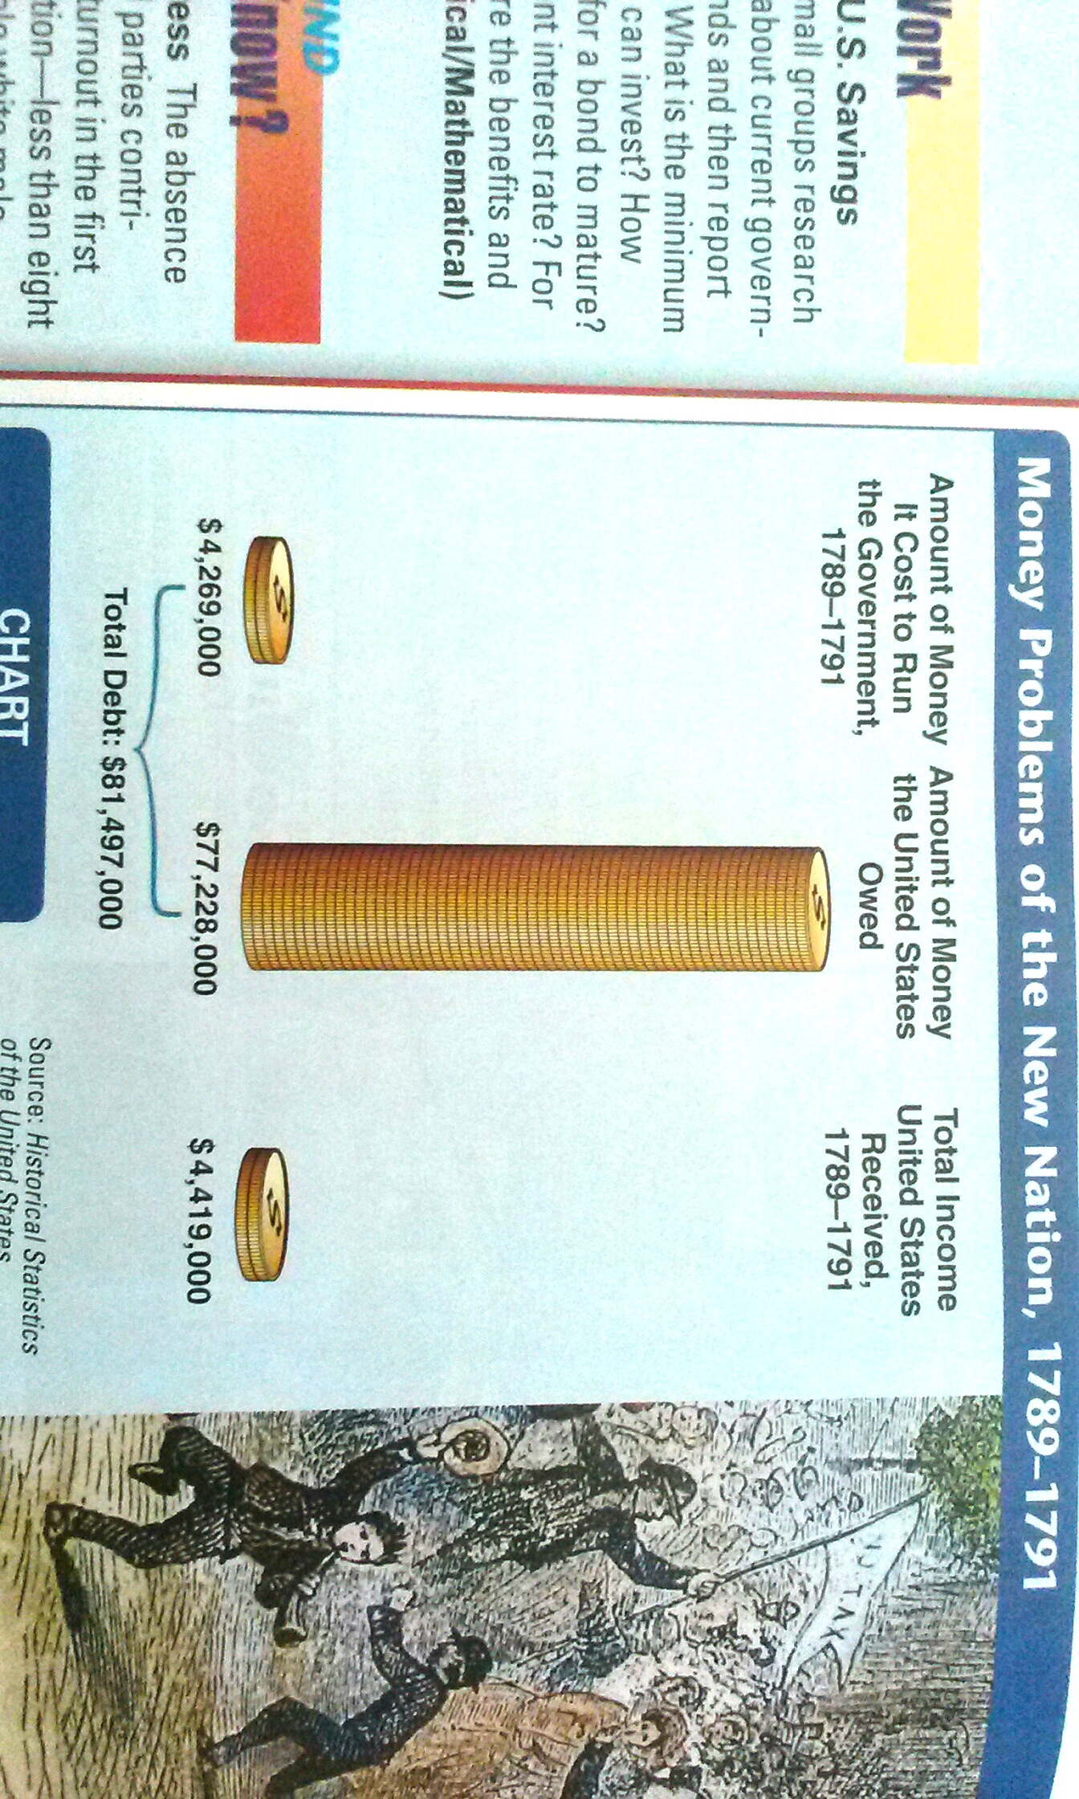
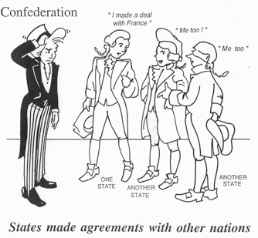
Not To Mention…
Trade with foreign nations- Just defeated it’s #1 source of trade in war
Financing the nation
Foreign relations (below)
What Do You Think is Happening In The Next Slide?

Slide 8
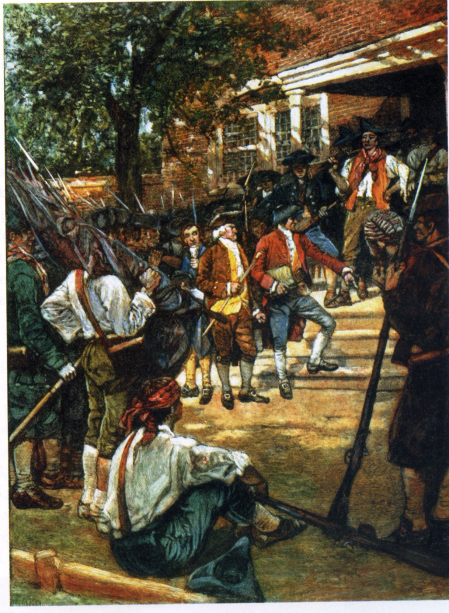

Slide 9
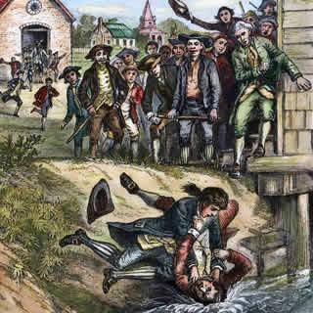
A Whole Lot of Problems
Depression- business slows, prices and pay falls and unemployment rises
Because of the depression, many soldiers who fought in the Revolution weren’t getting paid.
Most of these men were farmers and could not pay their debts

Slide 10
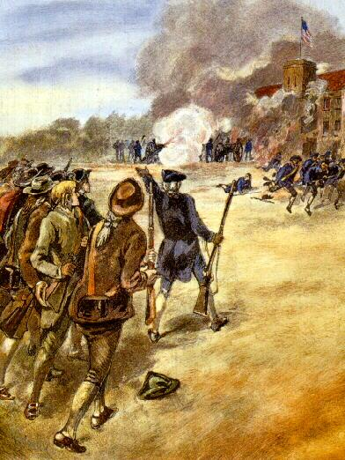
Shays’ Rebellion
The farmers were taken into court, jailed and land was taken away.
1786- an armed revolt by farmers against the state (MA) government took place.
Led by Daniel Shays, farmers began to forcibly prevent (stop) courts from meeting so they couldn’t take anyone else’s land away or put them in jail.
1787- the Governor sent 4,400 men against the rebels and the rebels were defeated.
Shays and the other rebels were pardoned (an official act of forgiveness)

Slide 11
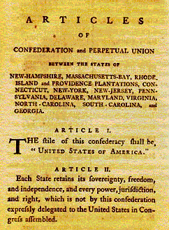
Conclusion?
Based on the many problems of the country, the United States realized the Articles of Confederation was a FAILED government!

Slide 12
Quick Quiz Question #1
The Articles of Confederation established a
Congress
A powerful president
A strong federal government
None of the above

Slide 13
Quick Quiz Answer #1
A. Congress

Slide 14
Quick Quiz Question #2
Which of the following was a power of the Articles of Confederation?
To establish an army and navy.
To regulate trade between the states.
To make the states honor promises.
To regulate the value of money.

Slide 15
Quick Quiz Answer #2
A. To establish an army and navy

Slide 16
Quick Quiz Question #3
Which of the following is true?
A. Larger states were represented more heavily than smaller states in Congress under the Articles of Confederation.
B. The states and the Federal government had equal power under the Articles of Confederation.
C. The Federal government was more powerful than the states under the the Articles of Confederation.
D. The states were more powerful than the Federal government under the Articles of Confederation.

Slide 17
Quick Quiz Answer #3
D. The states were more powerful than the Federal government under the Articles of Confederation.

Slide 18
Quick Quiz Question #5
The Land Ordinance of 1785
A. Allowed territories to become states in the population reached 60,000 free citizens.
B. Banned slavery in the Northwest territory.
C. Divided land into 6 square mile segments.
D. Had no impact on the development of the country.

Slide 19
Quick Quiz Answer #5
C. Divided land into 6 square mile segments.

Slide 20
Quick Quiz Question #6
The significance of the Northwest Ordinance (1787) was
A. It slowed immigration to America.
B. It allowed the young country to expand and develop.
C. It prevented the British from making any further attacks on America.
D. None of the above.

Slide 21
Quick Quiz Answer #6
B. It allowed the young country to expand and develop.

Slide 22
Quick Quiz Question #7
Shays’ Rebellion was primarily a result of
A. Farmer’s being unhappy about unsanitary working conditions.
B. Soldiers being upset that they had not yet been granted the right to vote.
C. Militia men who disliked the American court system.
D. The failure of the national government to raised funds (money).

Slide 23
Quick Quiz Answer #7
D. The failure of the national government to raised funds (money).

